Slide 1
Introduction to Concurrent Programming with GPUs
Python 3 Laboratory and Assignment Project Structure
Notes:
Get ready to explore the python 3 laboratory and assignment structure

Slide 2
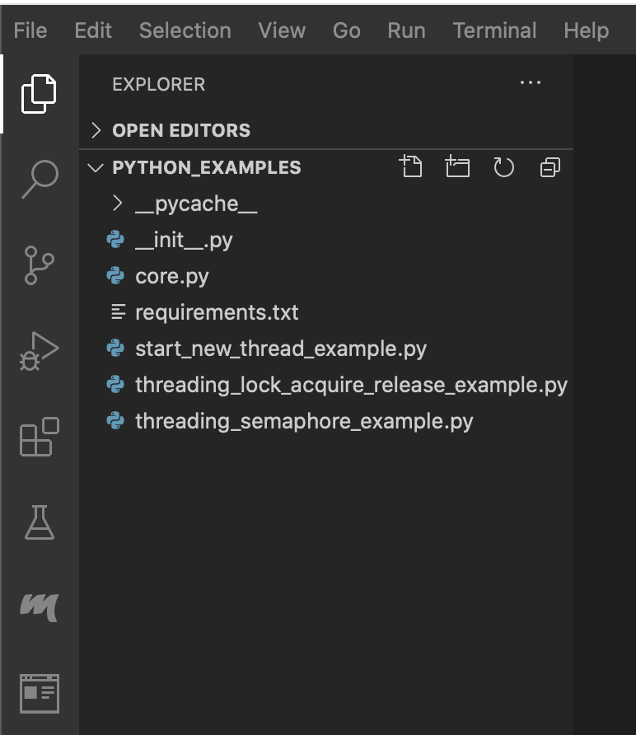
Python 3 Programming Lab Examples
Core functionality used across all other python files
Example code for using threading/_thread to create new threads and run in parallel
Example code for threading library’s Lock acquire and release capabilities
Example code for using threading library’s semaphore object
Notes:
The basic structure of the Python 3 programming labs are some required but unimportant files (__init__.py is needed for packaging and requirements.txt is used in conjunction with pip to retrieve the pydash library), the core functionality used across multiple .py files in cure.py, and the 3 example python code files.
The core.py has the purpose of holding a number of variables and functions that 3 example python files have in common.
The main focus of the three python parallel programming labs are around the base level parallel programming libraries, _thread and threading.
They will give avenues for exploration of threads, acquiring and releasing locks, and semaphores.

Slide 3
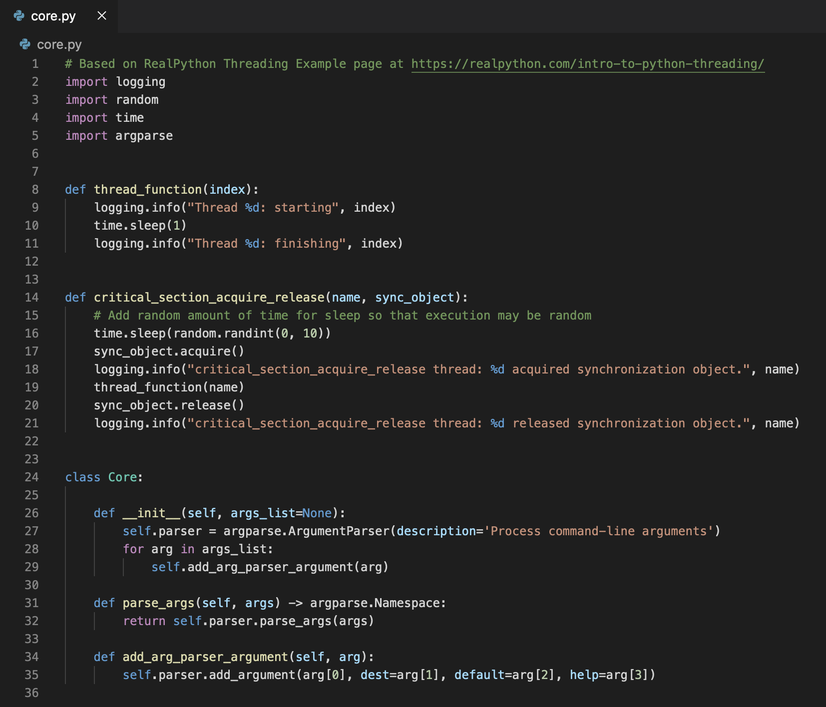
Core.py
The thread_function function holds the basic functionality of each thread
Executes thread_function within a synchronized critical section of code, using sync_object
Parse and define command line arguments in a descriptive manner
Notes:
The core.py file has two parts the static publicly available functions, thread_function and critical_section_acquire_release, and the Core class which is used for creating all executable code.
They will be useful in conjunction with threads and lock/sync objects to perform basic parallel programming.
The Core class has a constructure that takes a list of quadruples, tuples with 4 values, for flag letters like h for help, destination variable that passed argument values will be placed, the default value for the variable, and the descriptive text for help output.
The add_arg_parser_argument function takes a single quadruple and converts it for use with the argument parsing library argparser.
The parse_args takes a list of arguments and initializes the destination variables based on command line arguments passed to any executable that includes a Core object.

Slide 4
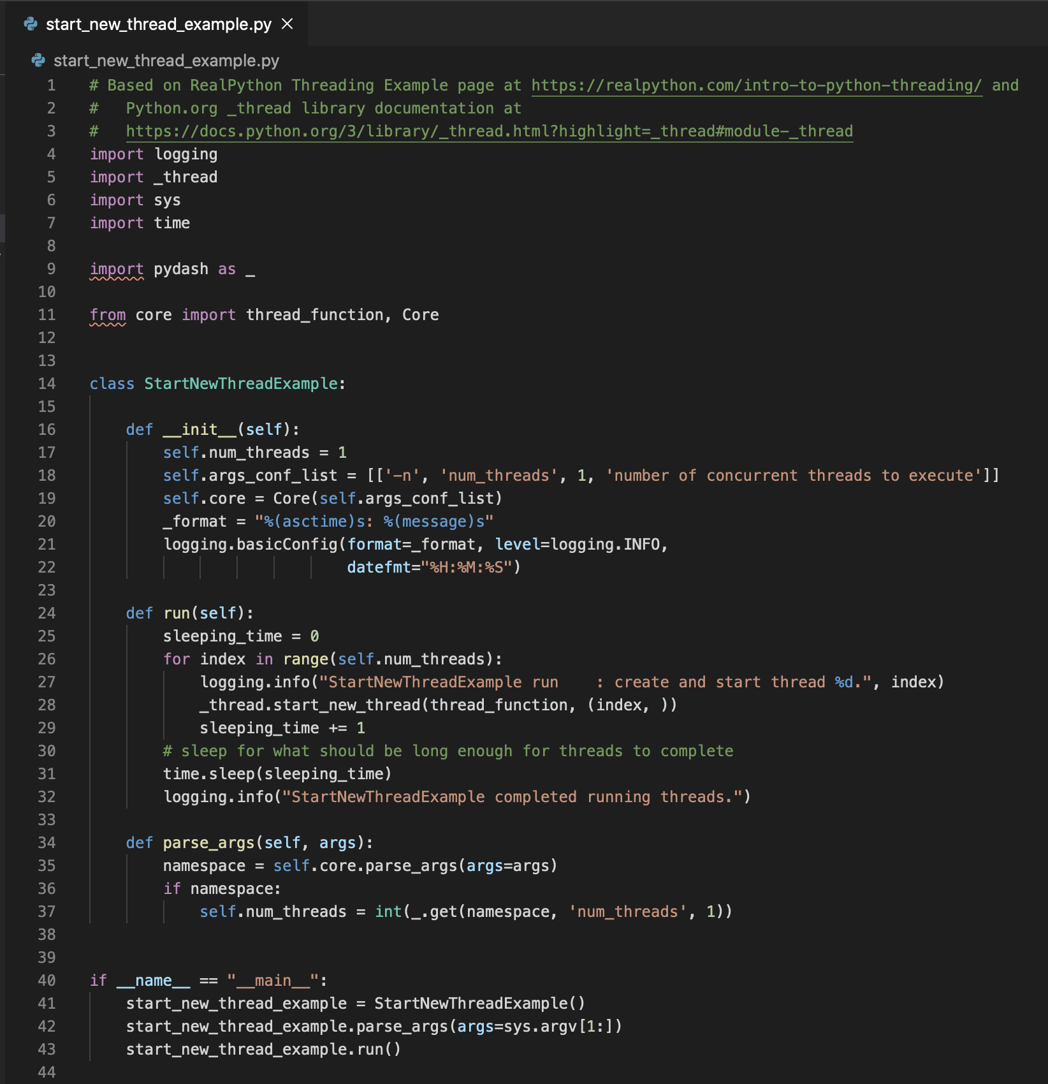
Basic Thread Function Example Code
Constructor for the StartNewThreadExample object
main executed function, which executes a user-defined number of threads, logging various states
This function parses the one thread this class takes, the number of threads to execute
Notes:
The constructor sets up the Core object to parse the –n argument that is used to retrieve the number of threads that will be executed in parallel.
The run function is use to concurrently execute the same code (thread_function from core.py) for each thread.
The parse_args sets up the core object of this class to process the passed command line arguments for the number of threads variable.

Slide 5
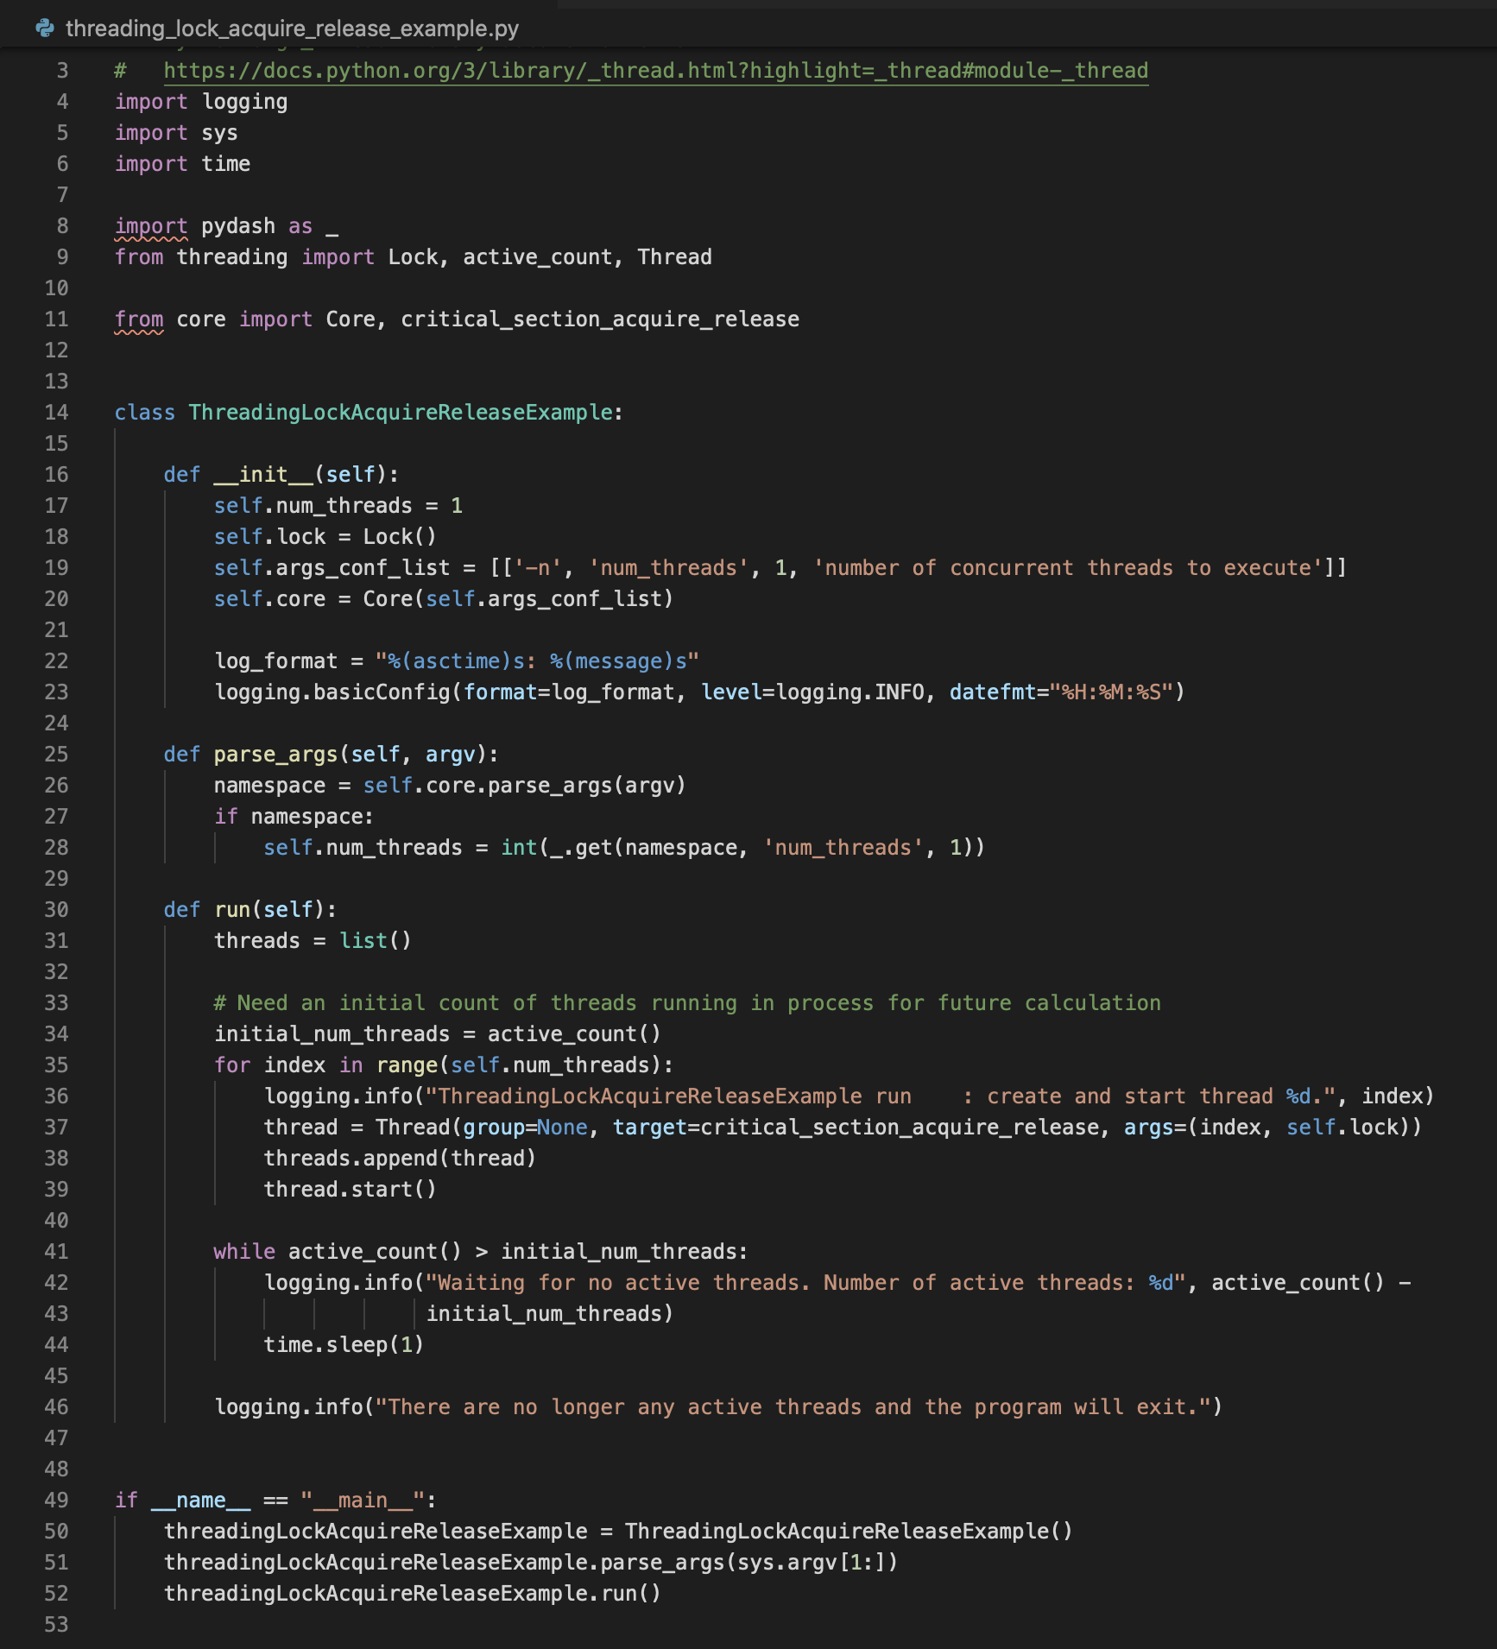
Python 3 Lock Acquire and Release Example Code
This python file’s structure is similar to the thread example code
The major difference is that a Lock is shared amongst all threads
That Lock is then used by threads to ensure that each thread doesn’t execute the critical section of code at the same time.
Notes:
This code should seem familiar to the previous slides, this is purposeful.
It was designed to fit a simple pattern that can be updated or expanded while keeping functions organized coherently between different examples.
For each thread started in the run method, the created Thread objects are executed in parallel, executing the same critical section of code.
The Lock object is used specifically to ensure that no two threads enter the same critical section of code at the same time.

Slide 6
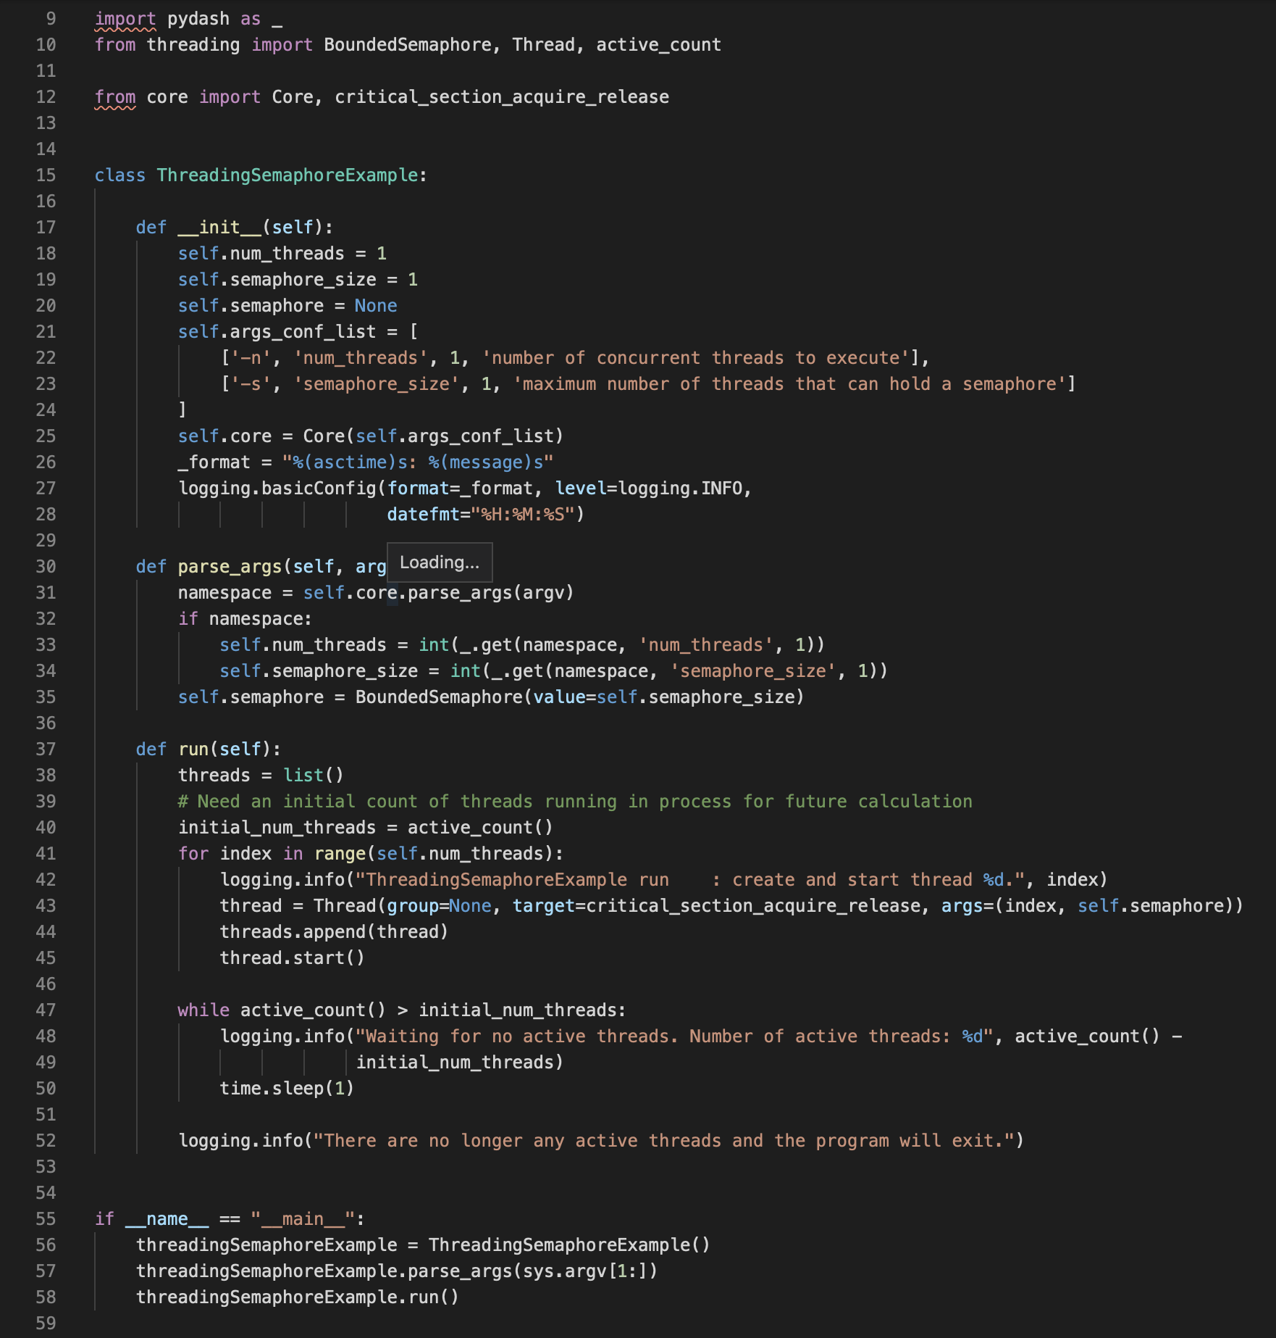
Python 3 Semaphore example
This code takes 2 command line arguments the number of threads and the size of the semaphore.
The semaphore size determines how many concurrent threads can access the same critical section of code simultaneously
The major difference between the lock and semaphore implementations is the underlying object Lock and Semaphore.
Notes:
The semaphore example shown here executes a user-defined number of threads with a predefined number of entrants into a critical section of code based on the size of the semaphore.
Each thread executes the same critical_section_acquire_release function with a different type of synchronization object.
Semaphores are locks that allow a larger number of threads to execute the same critical section of code.

Slide 7
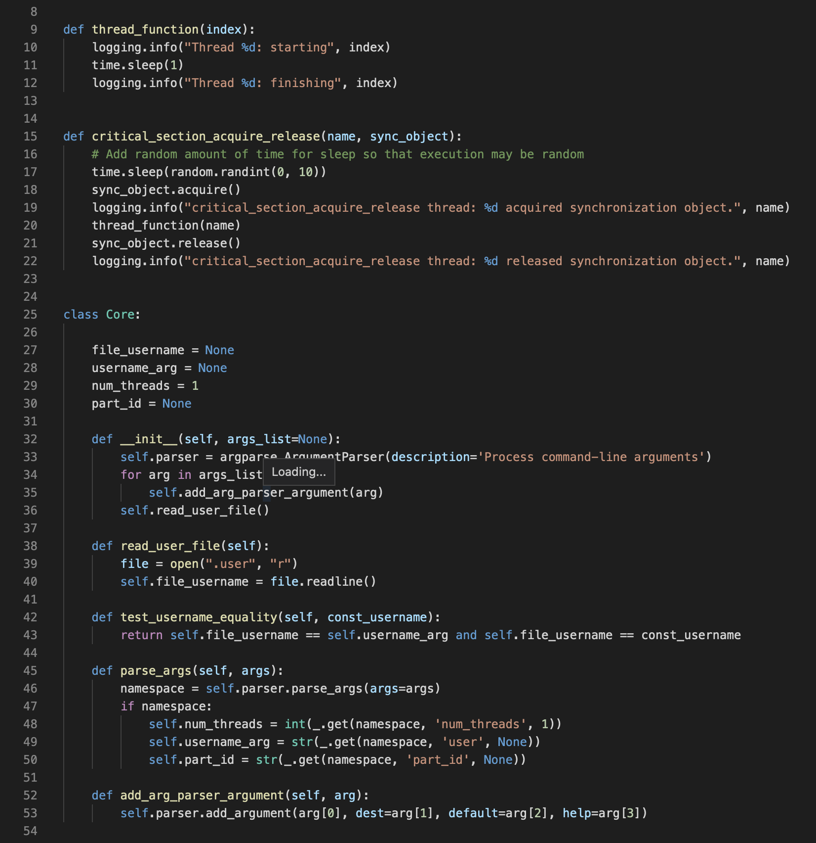
Python 3 Assignment Updated Core.py
The new constructor adds reading. in of the .user file
This function reads in the .user file in the current directory
Tests if the configured user is equivalent to the passed username
This version of Core allows for 3 command line arguments
Notes:
The new core object has variables for number of threads, username file, the CLI argument passed username, and Coursera assignment part id.
The read_user_file and test_username_equality functions are used to verify submitted code.
The parse_arguments in this case, now part of core.py and not in the example python file, adds arguments for number of threads, username, and part id.

Slide 8
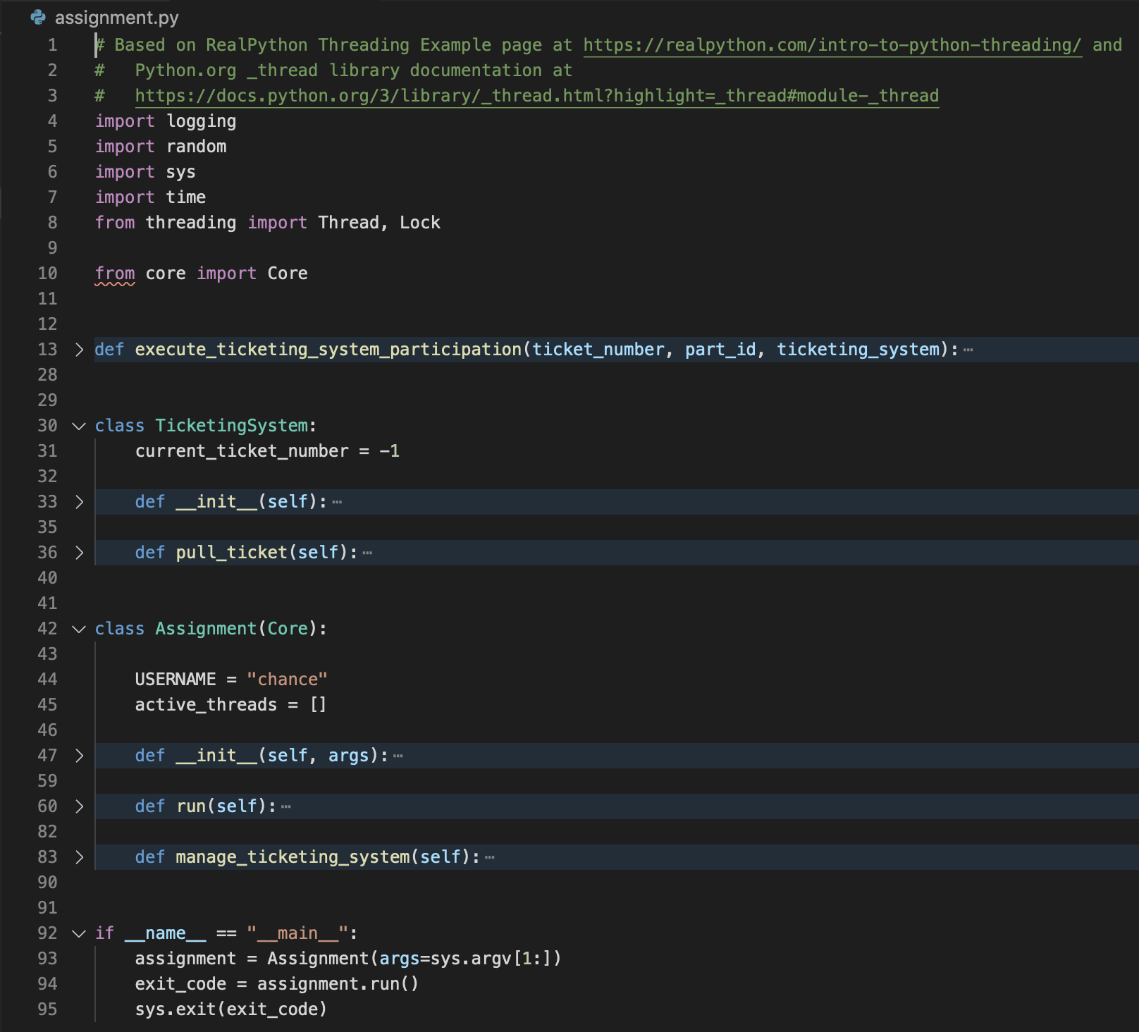
Assignment.py
This static function that executes the main functionality of the ticketing system
The TicketingSystem class constructor and the function to pull a ticket
Assignment class which runs the code in general and specifically manages the ticketing system
Notes:
The predefined classes and functions that are part of the assignment.py file should not be modified but the non-logging code should be filled out with any functional code that you need to implement a fully working ticketing system.
The execute_ticketing_system_participation is a function that is available to any code with the assignment.py file.
It takes a ticket number, the current assignment part id, and a ticketing system object.
It will perform any steps required to have numerous threads execute the critical code in the order that tickets were pulled.
The ticketing system should manage access tickets to make sure that any number of threads can pull tickets and this is used in connection with the Assignment classes manage_ticketing_system function to ensure that all threads execute their code in the order that they pulled tickets from the ticketing system.

Slide 9
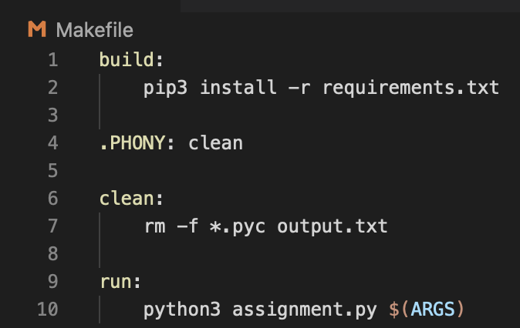
Makefile
This Makefile has three targets for:
Cleaning artifacts
Building/retrieving required packages
Running the assignment code with arguments passed to the Makefile via the ARGS environment variable.
Notes:
The Makefile shown here is useful for making the assignment.py file execute correctly.
Run ‘make clean build’ to remove any compiled python files and install any required python packages.
The last step will be to run ‘make run ARGS="-n $NUM_THREADS -u $USERNAME -p $PART_ID”’, you will need to either set the environment variables for NUM_THREADS, USERNAME, and PART_ID, or just replace them in the make command example with values.
You should not need to modify or execute this directly as there will be a button in VS Code.

